Slide 2
Dr Dylan Foster Evans Hanes y Gymraeg yng Nghaerdydd The History of the Welsh Language in Cardiff
Dr Jeremy Evas Manteision Dwyieithrwydd The Benefits of Bilingualism

Slide 3
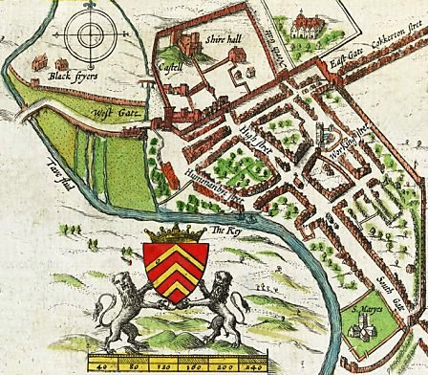
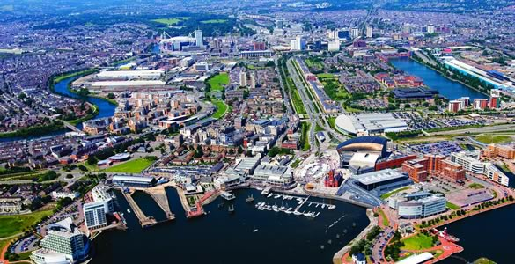
Hanes y Gymraeg yng Nghaerdydd
The History of the Welsh Language in Cardiff
Dr Dylan Foster Evans

Slide 4
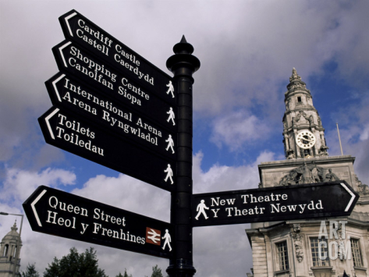
Enw - Name
Brythoneg *kagrotami
Cymraeg Canol Caerdyf
Cymraeg diweddar Caerdydd
Saesneg Cardiff
/'kɑːdɪf/, /'kæːdɪf/
Brittonic *kagrotami
Middle Welsh Caerdyf
Modern Welsh Caerdydd
English Cardiff
/'kɑːdɪf/, /'kæːdɪf/

Slide 5
Cymeriad ieithyddol ar ddechrau’r 19g Linguistic character in early 19th c.
Cymraeg yn brif iaith y fwrdeistref
Saesneg yn brin yn nifer o’r plwyfi sydd bellach yn rhan o Sir Caerdydd
Ond Saesneg yn amlwg iawn yn y fwrdeistref (diglosia)
Welsh the main language in the old town
English scarce in many of the parishes that now form the county of Cardiff
But English also very evident in the old town (diglossia)

Slide 6
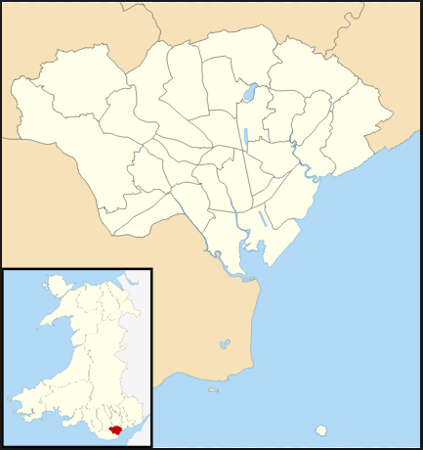

Slide 7
Cardiff Records, ed. J. H. Matthews
Notes of Information orally given to the Archivist by Mrs. MARY HARRIS and Mr. JOB RICHARDS, both of Tai Cochion, Roath, 17 October 1896.
I found Mrs. Harris a hale and intelligent woman, aged 81 years. She was born at Rumney, but had lived at Roath nearly all her life. She spoke Welsh much more readily than English, having known no English till she was a full-grown woman. Her daughter, aged about fifty, also spoke Welsh, but less fluently than English. Mr. Richards was then a hearty, clear-headed man of about 70 years. He was born in the parish, at Ffynon Bren cottage. He spoke Welsh and English with equal fluency.

Slide 8
John Bird (1761-1840), dysgu Cymraeg fel clerc ail Ardalydd Bute
1838: cyngor y dref yn mynnu bod clerc y farchnad yn siarad Cymraeg
4 capel Cymraeg yn agor yn y dref rhwng 1813 ac 1827
John Bird (1761-1840), clerk to the 2nd Marquess of Bute, learns Welsh
1838: town council requires the market clerk to be Welsh speaking
4 Welsh-speaking nonconformist places of worship open in the old town between 1813 and 1827

Slide 9
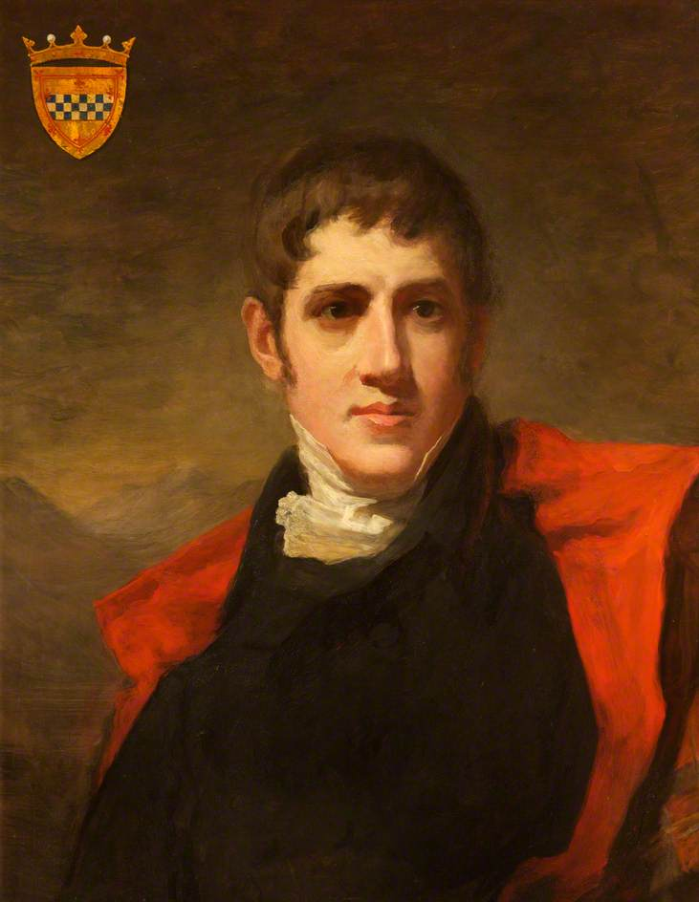
John Crichton Stuart (1793-1848)
2il Ardalydd Bute
2nd Marquess of Bute
[the Welsh language] is a ‘great storehouse of the people’s long treasured recollections and the distinctive barrier of their nationality’
His agent’s view (1833):
‘I conceive the continuance of the Language of no benefit to the Country and that any Society in any way assisting such continuance will not be productive of good’.
Notes:
Cefnogi’r Gymraeg mewn eisteddfodau, eglwysi, hyd yn oed addysg. Ond dim ond os oedd y Gymraeg yn cadw’r bobl rhag syniadau radical. Aeth yn gandryll pan ddaeth i wyvod am y syniadau radical yn Y Gweithiwr, papur radical Cyrmaeg o Ferthyr.

Slide 10
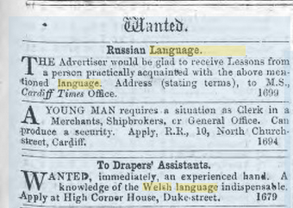
Cardiff Times, 6/3/1863
http://papuraunewyddcymru.llgc.org.uk/cy/page/view/3382548/ART1

Slide 11
Cymdeithasau diwylliannol Cultural associations
Cymreigyddion Caerdaf (1832)
Cymdeithas Cymrodorion Caerdydd (1885, sefydlwyd yn nhŷ coffi Edward Thomas (Cochfarf), Custom House Street)
‘Cardiff Welsh Society’ (1832)
‘Cardiff Cymrodorion Society’ (1885, founded in the coffee house of Edward Thomas (Cochfarf) on Custom House Street)

Slide 12
Addysg - Education
1897 – refferendwm ieithyddol yn arwain at ddysgu Cymraeg i blant 6 a 7 mlwydd oed
1905 – Cyngor y Ddinas yn gwneud y Gymraeg yn bwnc gorfodol
1897 – a ‘linguistic plebiscite’ held in Cardiff, which leads to teaching Welsh to 6 and 7 year olds
1905 – City Council makes Welsh a compulsory subject

Slide 13
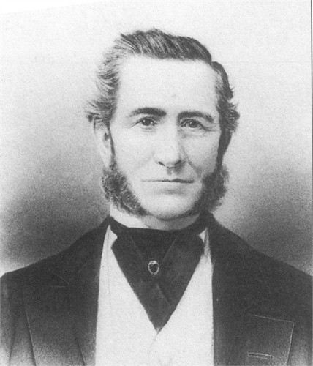
George Thomas (1821-98)
Ely Farm (Caerau)
Ffermwr, mesurwr tir, hynafiaethydd a chasglwr llên gwerin
Farmer, surveyor, antiquarian and collector of folk-lore
Eglwyswr a Thori rhonc
Anglican and ardent Tory

Slide 14
David Rhys Jones (1845-1925)
Meddyg yn Grangetown
Arbenigwr ar iechyd meddwl
Sosialydd (Ffabian) arloesol
Yn gefnogol i sosialaeth ac addysg drwy gyfrwng y Gymraeg (1890au)
Doctor in Grangetown
Expert in mental health
Socialist (Fabian) pioneer
A supporter of socialism and education through the medium of Welsh (1890s)

Slide 15
Llwyddiant Caerdydd ers y 1950au?
Cardiff’s success since the 1950s?
Trosglwyddo’r iaith rhwng cenedlaethau
Addysg Gymraeg
Profi y gall yr iaith fod yn iaith i bawb: nid i’r dosbarth gweithiol traddodiadol Cymraeg yn unig
Intergenerational language transmission
Welsh-medium education
Welsh can be a language for all: not just traditional working-class Welsh speakers

Slide 16
Dr Jeremy Evas

Slide 17
Buddion? Pa fuddion?
Benefits? What benefits?
3 chyfnod: negyddol, niwtral, cadarnhaol 3 periods: negative, neutral, positive

Slide 18
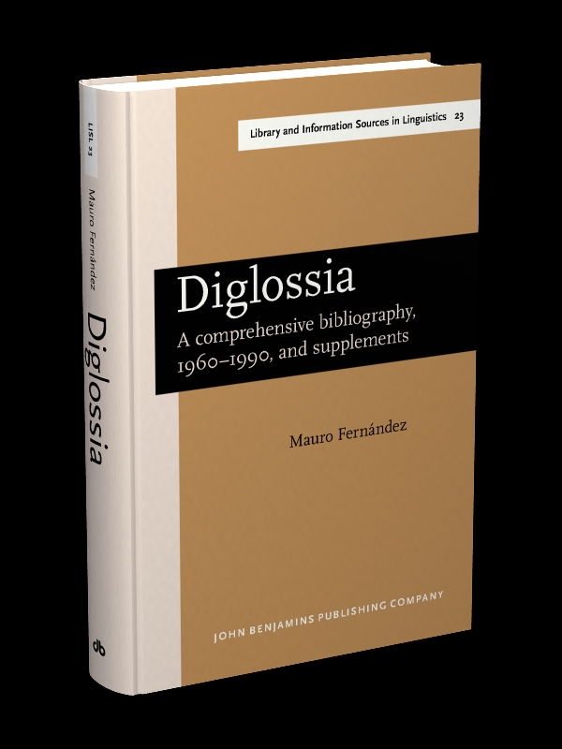
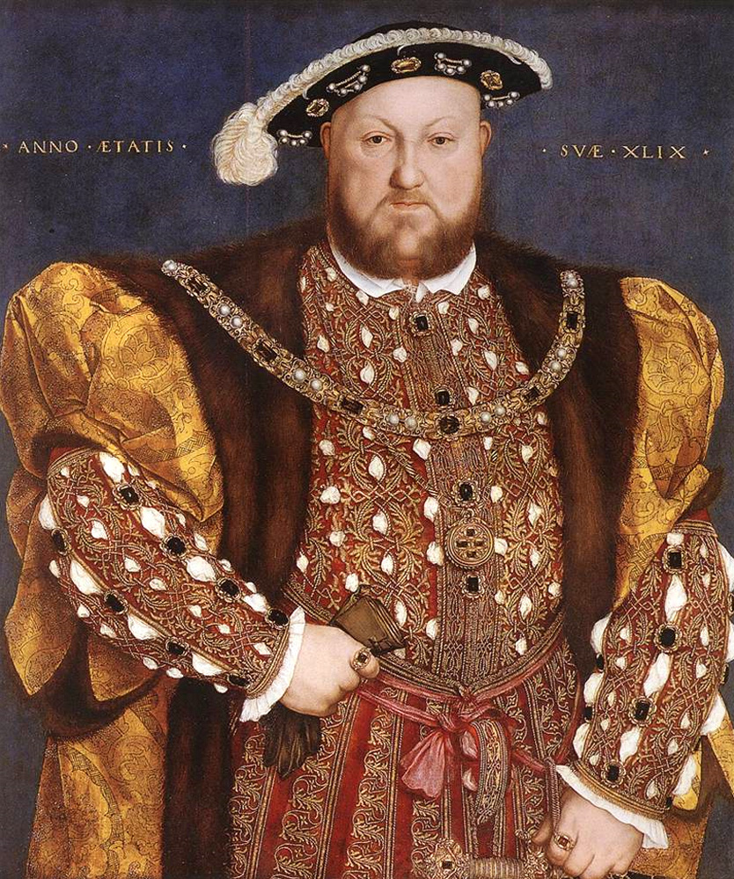

Slide 19
Diglossia
Dwy iaith, yn yr un diriogaeth, yn cael eu defnyddio gan yr un siaradwyr, at wahanol ddibenion
Mae statws uwch gan un o’r ieithoedd
Two languages, in the same geographical territory, used by the same speakers, for different functions
One language has higher status than the other

Slide 20
H(igh)
L(ow)

Slide 21
Diglossia
Functional Distribution of/Dosraniad ffwythiannol ‘H’ ac ‘L’ Ferguson, C.A. (1959) ‘Diglossia’, Word, 15, pp/tt. 325-40.

Slide 22
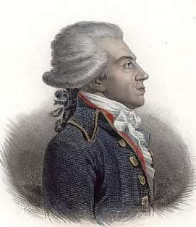
Bertrand Barère de Vieuzac
Parmi les idiomes anciens, welches, gascons, celtiques, wisigoths, phocéens ou orientaux, qui forment quelques nuances dans les communications des divers citoyens et des pays formant le territoire de la République, nous avons observé […] que l'idiome appelé bas-breton, l'idiome basque, les langues allemande et italienne ont perpétué le règne du fanatisme et de la superstition, assuré la domination des prêtres, des nobles […], empêché la révolution de pénétrer dans neuf départements importants, et peuvent favoriser les ennemis de la France.
Rapport du Comité de salut public sur les idiomes
Le 8 pluviôse an II (27 janvier 1794)
"Le fédéralisme et la superstition parlent bas-breton; l'émigration et haine de la République parlent allemand... La Contre-révolution parle l'italien et le fanatisme parle basque. Cassons ces instruments de dommage et d'erreurs."

Slide 23
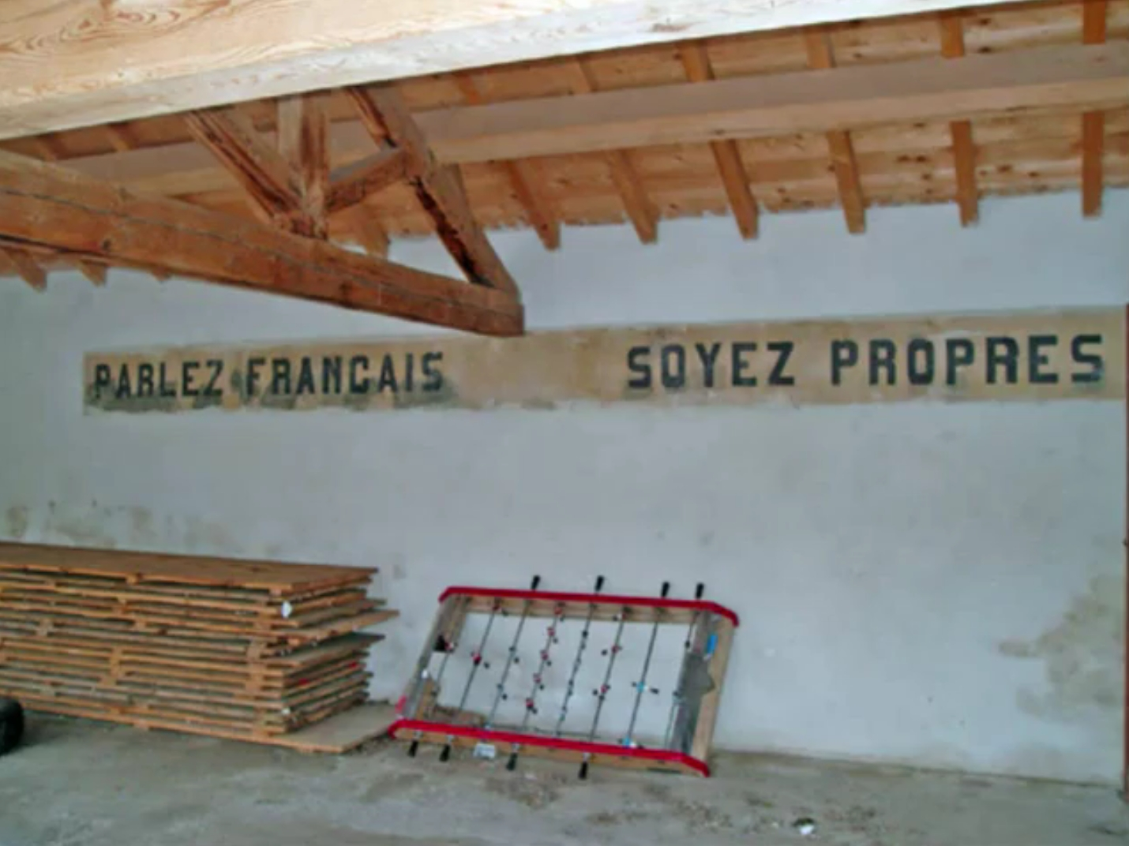

Slide 24
Rhanbarthau Sbaen/Spanish Regions
Háblame en Cristiano
(Siarada [nid ‘siaradwch’] gyda fi mewn iaith Gristnogol/ Talk to me in a Christian language)

Slide 25
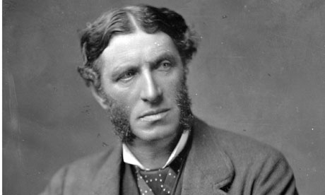
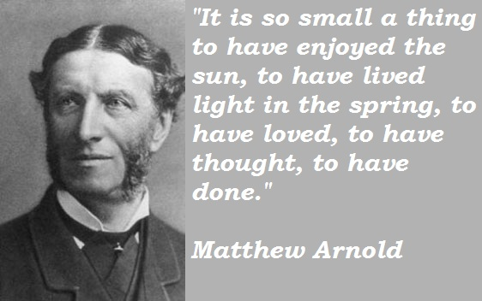
Matthew Arnold...
On the Study of Celtic Literature (1867)
The sooner the Welsh language disappears as an instrument of the practical, political, social life of Wales, the better; the better for England, the better for Wales itself.

Slide 26
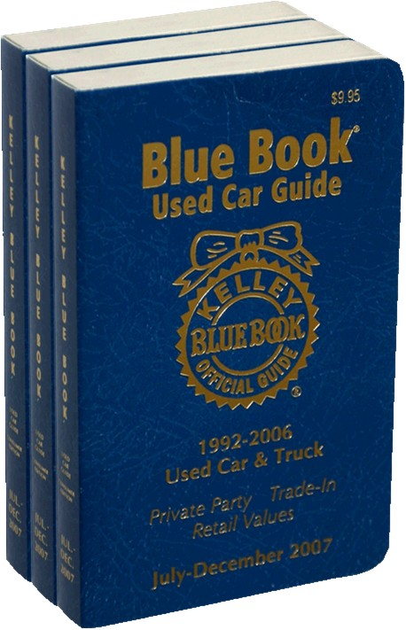
Superstition prevails. Belief in charms, supernatural appearances, and […] witchcraft, sturdily survive all the civilisation and light which has […] banished these remnants of the dark ages elsewhere. Little or none of such light has as yet penetrated the […] darkness which, harboured by their language, and undisturbed by availing efforts of enlightenment, enshrouds the minds of the people (II, 64)
1847

Slide 27
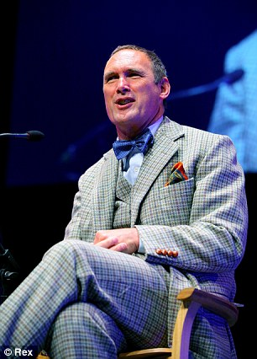
A.A. Gill (1998)
“loquacious, dissemblers, immoral liars, stunted, bigoted, dark, ugly, pugnacious little trolls”

Slide 30
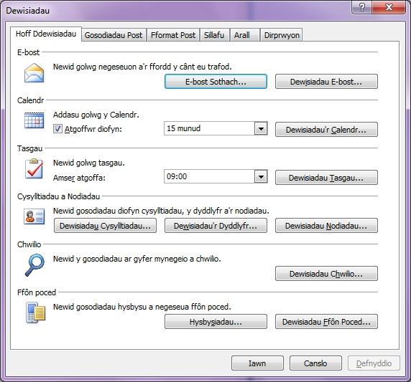

Slide 31
Mae magu neu addysgu plant i fod yn uniaith, dwyieithog neu amlieithog yn benderfyniad hynod bwysig
Raising or educating children to be monolingual, bilingual or multilingual is a crucial decision

Slide 32
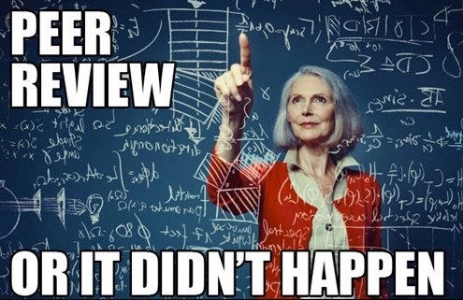

Slide 33
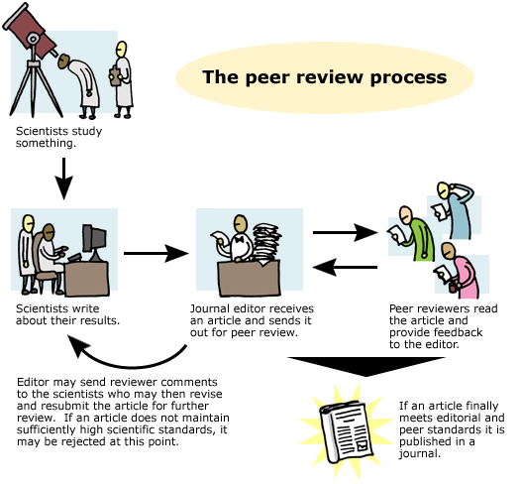

Slide 34
Sapir Whorf

Slide 36
Sapir Whorf
Did you know that suburban white males have over 100 words for ‘lawn’?

Slide 37
Effeithiau cadarnhaol: Positive effects on:
Hunaniaeth/Identity
Cyfeillgarwch/Friendships
Cyflogaeth/Employment
Teithio/Travel
Meddwl/Thinking

Slide 38
Gwybyddol/Cognitive
Ymwybyddiaeth Fetawybyddol/
Rhesymu Haniaethol/ Symbolaidd
Meddwl Creadigol a dargyfeiriol
Datrys Problemau
Metacognitive Awareness
Abstract/Symbolic Reasoning
Creative and Divergent Thinking
Problem Solving

Slide 39
Bilingualism as a protection against the onset of symptoms of dementia Bialystok et al Neuropsychology 45 (2007) 459-464
Bilingualism has been shown to enhance attention and cognitive Control in both children (Bialystok, 2001) and older adults (Bialystok, Craik, Klein & Viswanathan, 2004)
N=228 referred to a Memory clinic with cognitive complaints, 51% bilingual
The bilinguals showed symptoms of dementia 4 years later than monolinguals, all other measures being equivalent

Slide 40
Bialystok et al... (1)
A possible reason for the enhanced cognitive Control demonstrated by bilingual children is that the same Control processes are used both to solve these misleading problems and to manage two active systems.

Slide 41
Bialystok et al...(2)
Bilingual children, therefore, have had more opportunity than monolinguals to exercise a crucial cognitive skill, and this practice may then accelerate the development of that skill Bialystok et al, ‘Effect of bilingualism on cognitive Control in the Simon task: evidence from MEG [Magneto-encephalography] NeuroImage 24 (2005) 40-49

Slide 42
Bialystok et al...(3)

Slide 43
“A systematic Review and Meta-Analysis of the Cognitive Correlates of Bilingualism”
Adolygwyd: 63 Astudiaeth a adolygwyd gan gymheiriaid (6,022 cyfranogwr) 63 Peer-reviewed studies (6,022 participants) were reviewed
Adescope, Lavin, Thompson, Ungerleider, Review of Educational Research, 2010 (80:207) (itself peer-reviewed/adolygwyd gan gymheiriaid ei hun)
...shows the weighted mean effect sizes for different cognitive outcomes associated with bilingualism. All the outcome measures produced statistically detectable mean effect sizes in favour of bilingualism. (218)

Slide 44
Manteision o ran Cyfathrebu/ Communication Advantages
Cylch ehangach o ran cyfathrebu
Deulythrennedd
Gwell dyfnder ac ehangder o ran diwylliant
Wider communication
Biliteracy
Broader culturalisation

Slide 45
Manteision Cwricwlaidd/ Curriculum Advantages
Gwell perfformiad cwricwlaidd
Haws dysgu trydedd/ pedwaredd iaith
Increased curriculum achievement
Easier to learn third/ fourth language
Notes:
Cyflwyniad yn mynd drwy'r papur yn gyflym, prif bwyntiau:
cefndir - pam?
gwaith datblygol - beth ydan ni wedi ei wneud yn barod?
pa ymchwil ydyn ni wedi ei wneud?
argymhellion ar gyfer cyfnod y Cynllun Corfforaethol presennol

Slide 46
Manteision Sgiliau Skills Advantages
Economaidd a gyrfaol
Sgil yw’r Gymraeg – gellir ei dysgu
Economic and employment
Welsh is a skill – it can be taught and learnt
Notes:
Cyflwyniad yn mynd drwy'r papur yn gyflym, prif bwyntiau:
cefndir - pam?
gwaith datblygol - beth ydan ni wedi ei wneud yn barod?
pa ymchwil ydyn ni wedi ei wneud?
argymhellion ar gyfer cyfnod y Cynllun Corfforaethol presennol

Slide 47
