Slide 1
Children and Young People with Cerebral Palsy’s Wheel of Participation about Recreational Activities
5th International Conference,
Researching children's everyday lives: socio-cultural contexts
Dawn Pickering, Senior Lecturer,
Kenwood Hall, Sheffield, UK
2nd July 2014

Slide 2
Objectives
Global context of Cerebral Palsy/ Disabled child
UK
Pilot study Wales/ England-
  ‘Wheel of participation’
Development of PhD proposal

Slide 3
Children with Disabilities
Macro- World Health/ Europe
Meso-UK Health Policies (& Education)
Micro- Child and Family/ Healthcare professionals
Notes:
Pilgrim and Rogers (1999) have defined a three tier analytical framework describing Macro, Meso and Micro levels. At the Macro level, the World Health Organisation developed the International Classification of Functioning (WHO, 2007) which has ‘Participation’ as one of its domains. UNICEF focussed their annual ‘State of the world’s children’ on disabled children for 2013 (UNICEF, 2013). This embeds the values of children’s rights (UNCRC, 1989).
At the Meso level there are national guidelines such as the National Institute for Clinical Excellence (NICE) guideline to increase walking and cycling participation (NICE, 2012). The Chief Medical Officer proposes that children with neurological conditions are given a higher priority (Department of Health, 2013). In Wales, the Bevan report highlighted limited opportunities for disabled children (Bevan, 2011).
At the micro level there are practitioners, parents, C & YP with CP who attempt to interpret these guidelines into their practice and everyday life.
By increasing the understanding of the ‘lived experiences’ of a specific group of C & YP with CP the findings will have transferability to other disabilities. For health and social care professionals this may be of value to signpost clients/patients and their families to opportunities which may increase their participation to enhance their well-being.

Slide 4
Macro
World Health Organisation: Public Health;
International Classification of Functioning (ICF) 2001, ICF-CY 2007
United Nations Convention on the Rights of the Child – articles 23, 28, 29 and 31
United Nations Children’s Fund 2013
SPARCLE Project - 2004 onwards

Slide 5
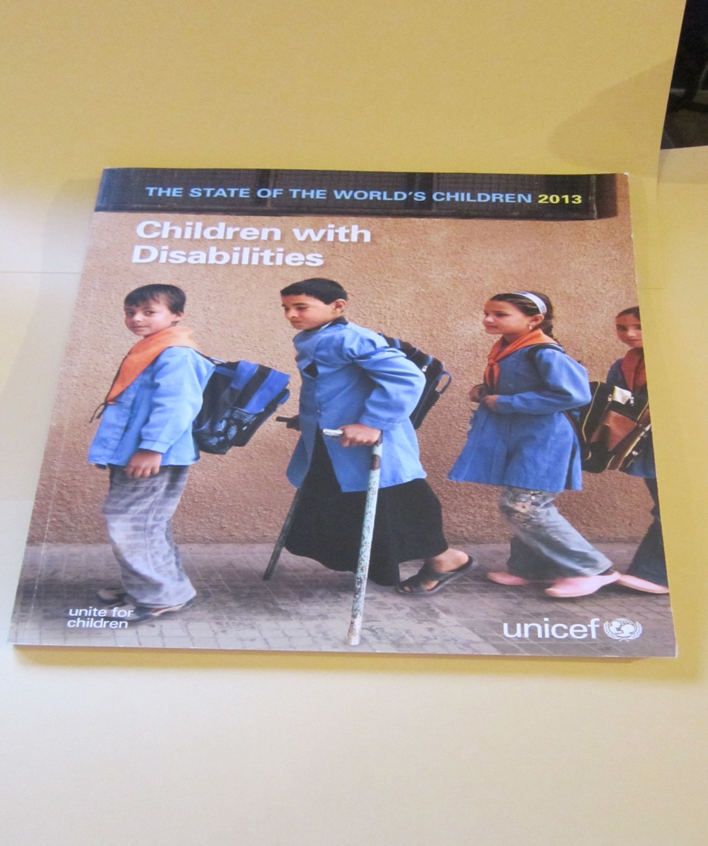
UNICEF 2013

Slide 6
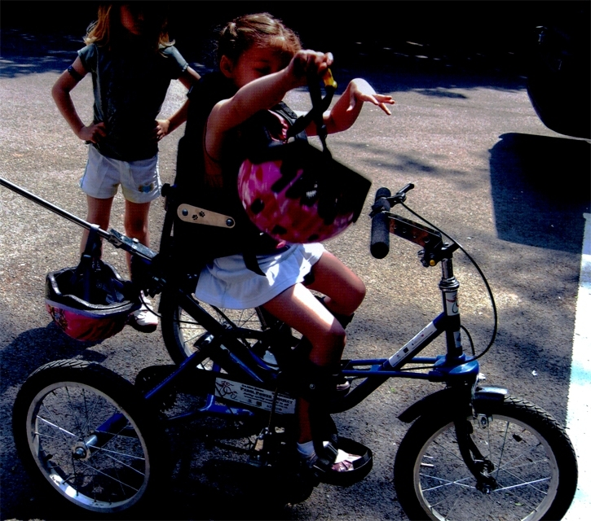
Adapted bikes
Mobility: Assistive Technology Device

Slide 7
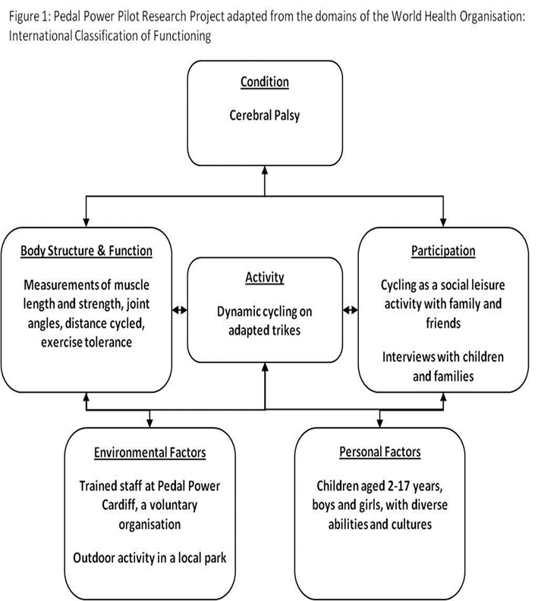
Application of International Classification of Functioning (ICF): Cycling

Slide 8
Study of Participation of children with Cerebral Palsy Living in Europe- SPARCLE
"The individual is rarely going to be altered
very much whereas the environment
slowly but surely can”
Tom Shakespeare
Notes:
Quality of life and participation

Slide 9


Slide 10
UK
National Institute for Clinical Excellence (NICE) guidelines to increase walking and cycling (2012)
NHS policy: Family/ Child Centred Care
Chief Medical officers Report 2013
Bevan Foundation report, 2011 (Wales)
Education Policy - Inclusion
Notes:
Pilgrim and Rogers (1999) have defined a three tier analytical framework describing Macro, Meso and Micro levels. At the Macro level, the World Health Organisation developed the International Classification of Functioning (WHO, 2007) which has ‘Participation’ as one of its domains. UNICEF focussed their annual ‘State of the world’s children’ on disabled children for 2013 (UNICEF, 2013). This embeds the values of children’s rights (UNCRC, 1989).
At the Meso level there are national guidelines such as the National Institute for Clinical Excellence (NICE) guideline to increase walking and cycling participation (NICE, 2012). The Chief Medical Officer proposes that children with neurological conditions are given a higher priority (Department of Health, 2013). In Wales, the Bevan report highlighted limited opportunities for disabled children (Bevan, 2011).
At the micro level there are practitioners, parents, C & YP with CP who attempt to interpret these guidelines into their practice and everyday life.
By increasing the understanding of the ‘lived experiences’ of a specific group of C & YP with CP the findings will have transferability to other disabilities. For health and social care professionals this may be of value to signpost clients/patients and their families to opportunities which may increase their participation to enhance their well-being.

Slide 11
Micro
Mixed methods study 35 children and young people England/ Wales.
Qualitative data here (EACD quantitative data)
Mosaic methods (Pickering et al, 2012)
43 interviews and 22 diaries
Thematic analysis

Slide 12
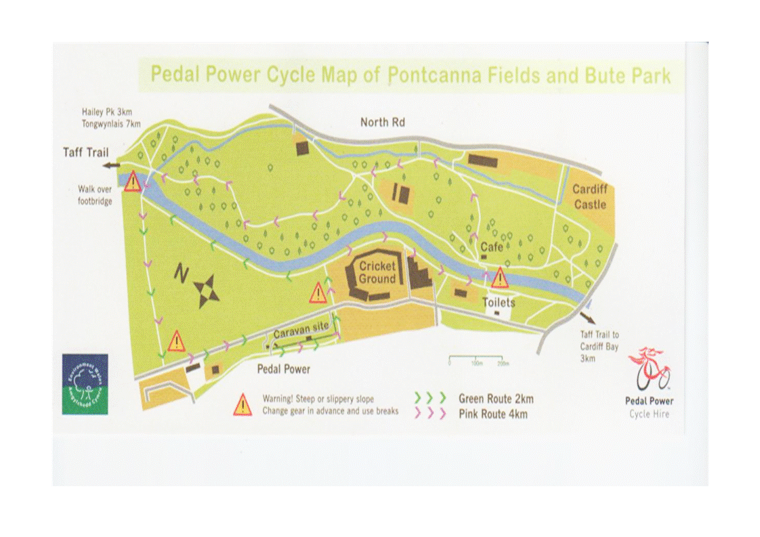
Environment of cycle hire centre

Slide 13
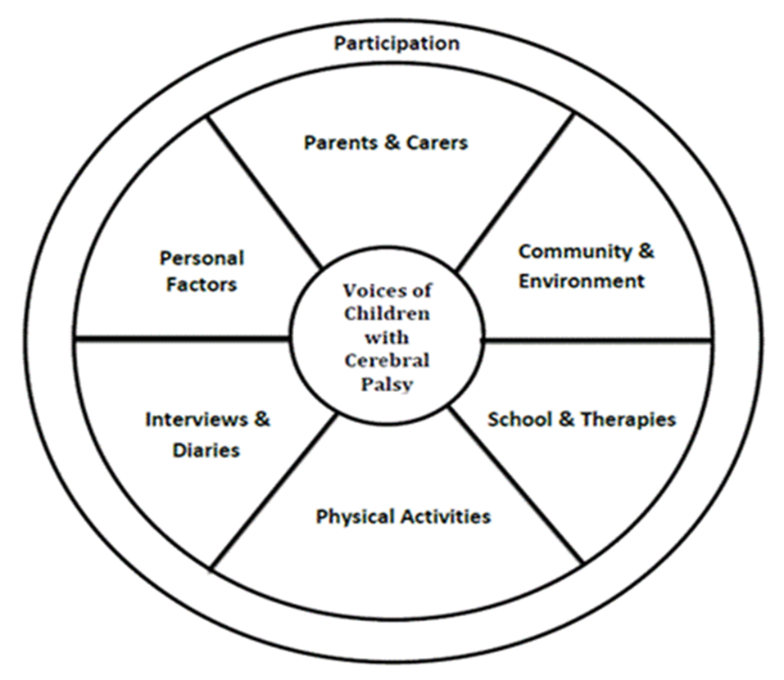
‘Wheel of participation’ ^{Pickering et al in press, 2014}
Voices

Slide 14
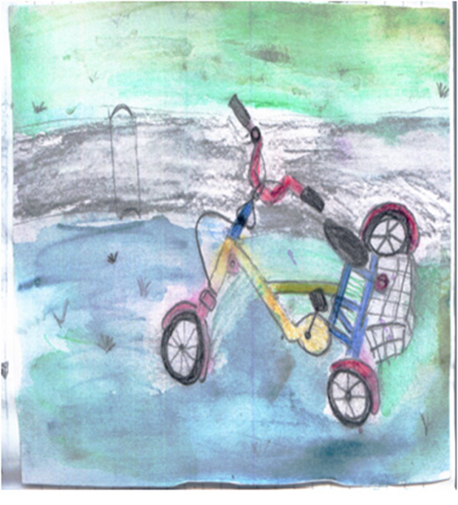
Community: 'Diane’ aged 10
Interview
“..at the caravan park it was much easier
than walking …I cycled quickly with my friends
and we chased each other on bikes and went to
buy sweets at the village shop…we cycled on
our own without Mum and Dad to the
‘lagoon’[see drawing]…when I don’t
have my bike I tag along with others for
a while...ponder my thoughts… get
bored... in the city there aren’t enough
safe places to cycle but at the caravan its
easier to get around- it’s a clever ,clever
invention whoever invented it I want to
thank them…..”

Slide 15
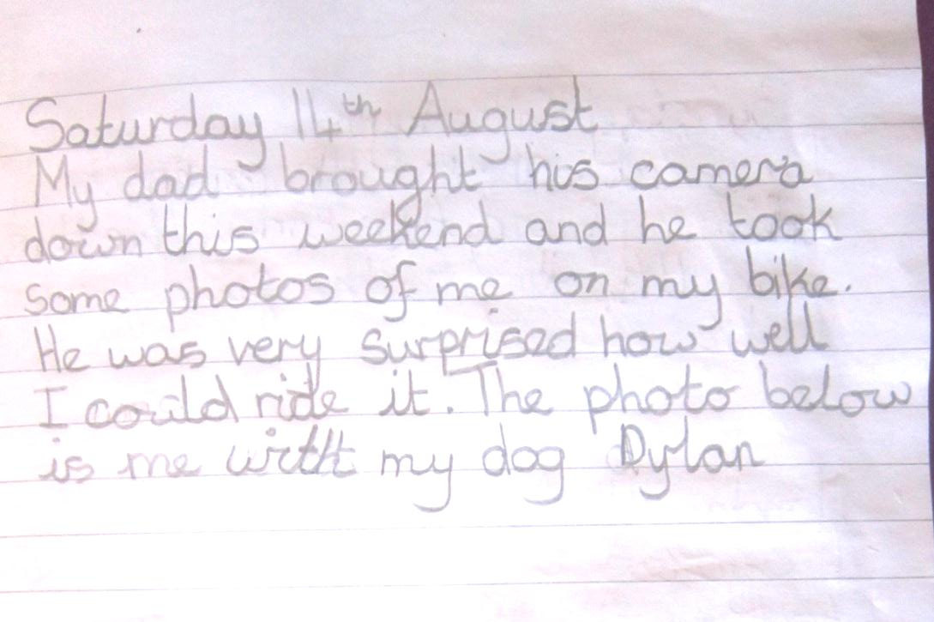
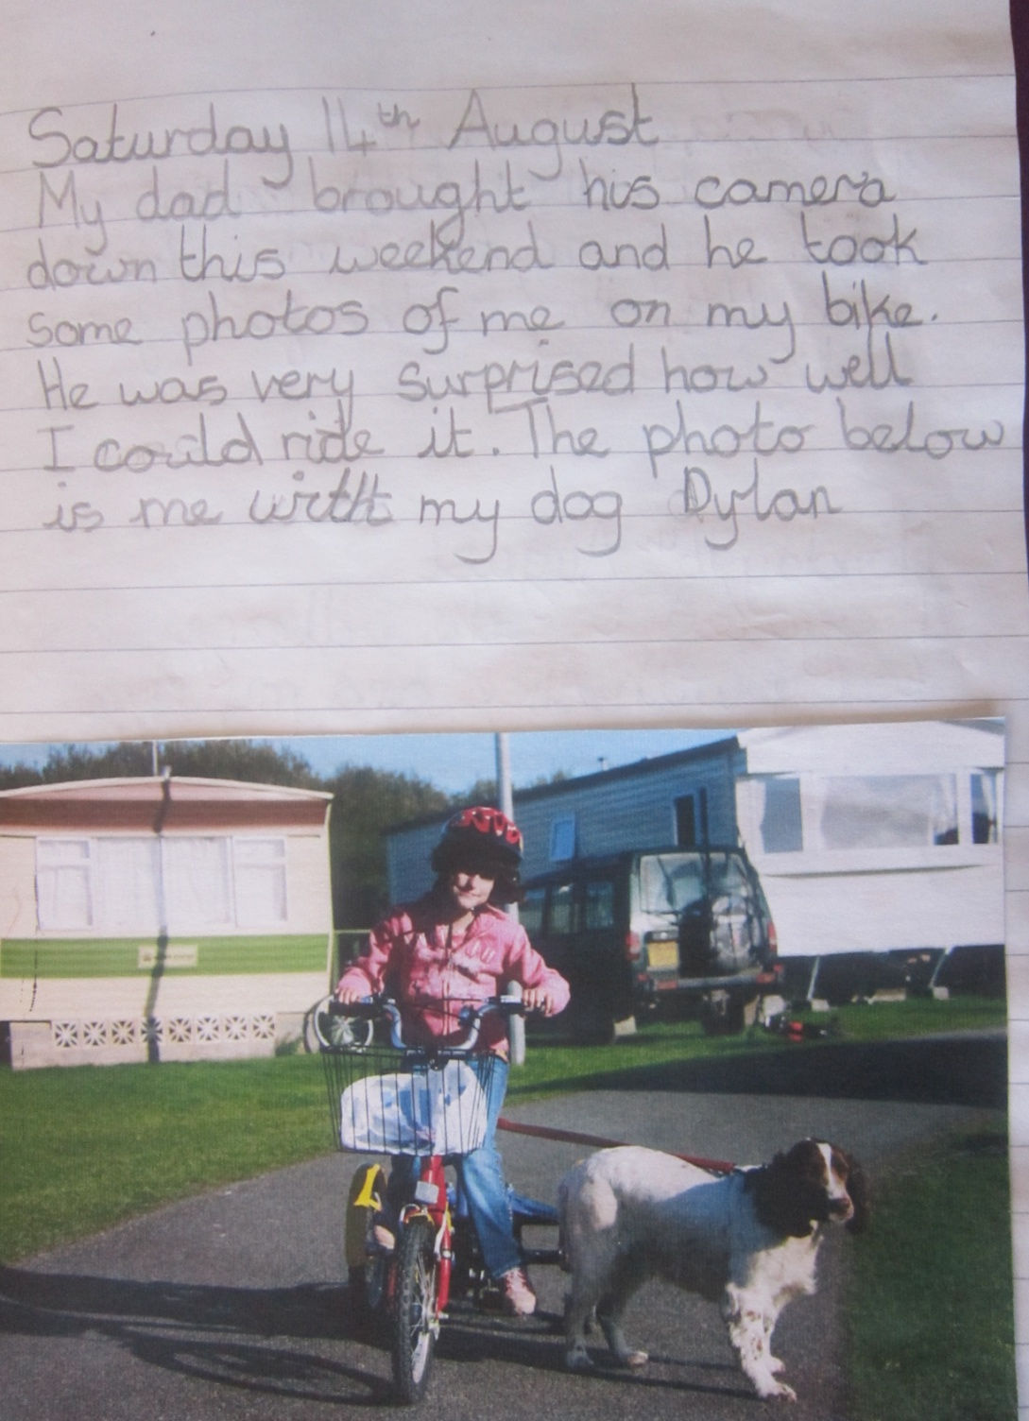
Diane’sDiary entry- cycling skills

Slide 16
School Cycling experiences
Becky aged 4 years attended mainstream school
Diary entry, written by mum: “…It’s bike day at school. All of the children are taking their bikes…Apparently she had another good session, cycling enthusiastically and proudly on her bike
( not sure how long-should think it was a good hour)….”

Slide 17
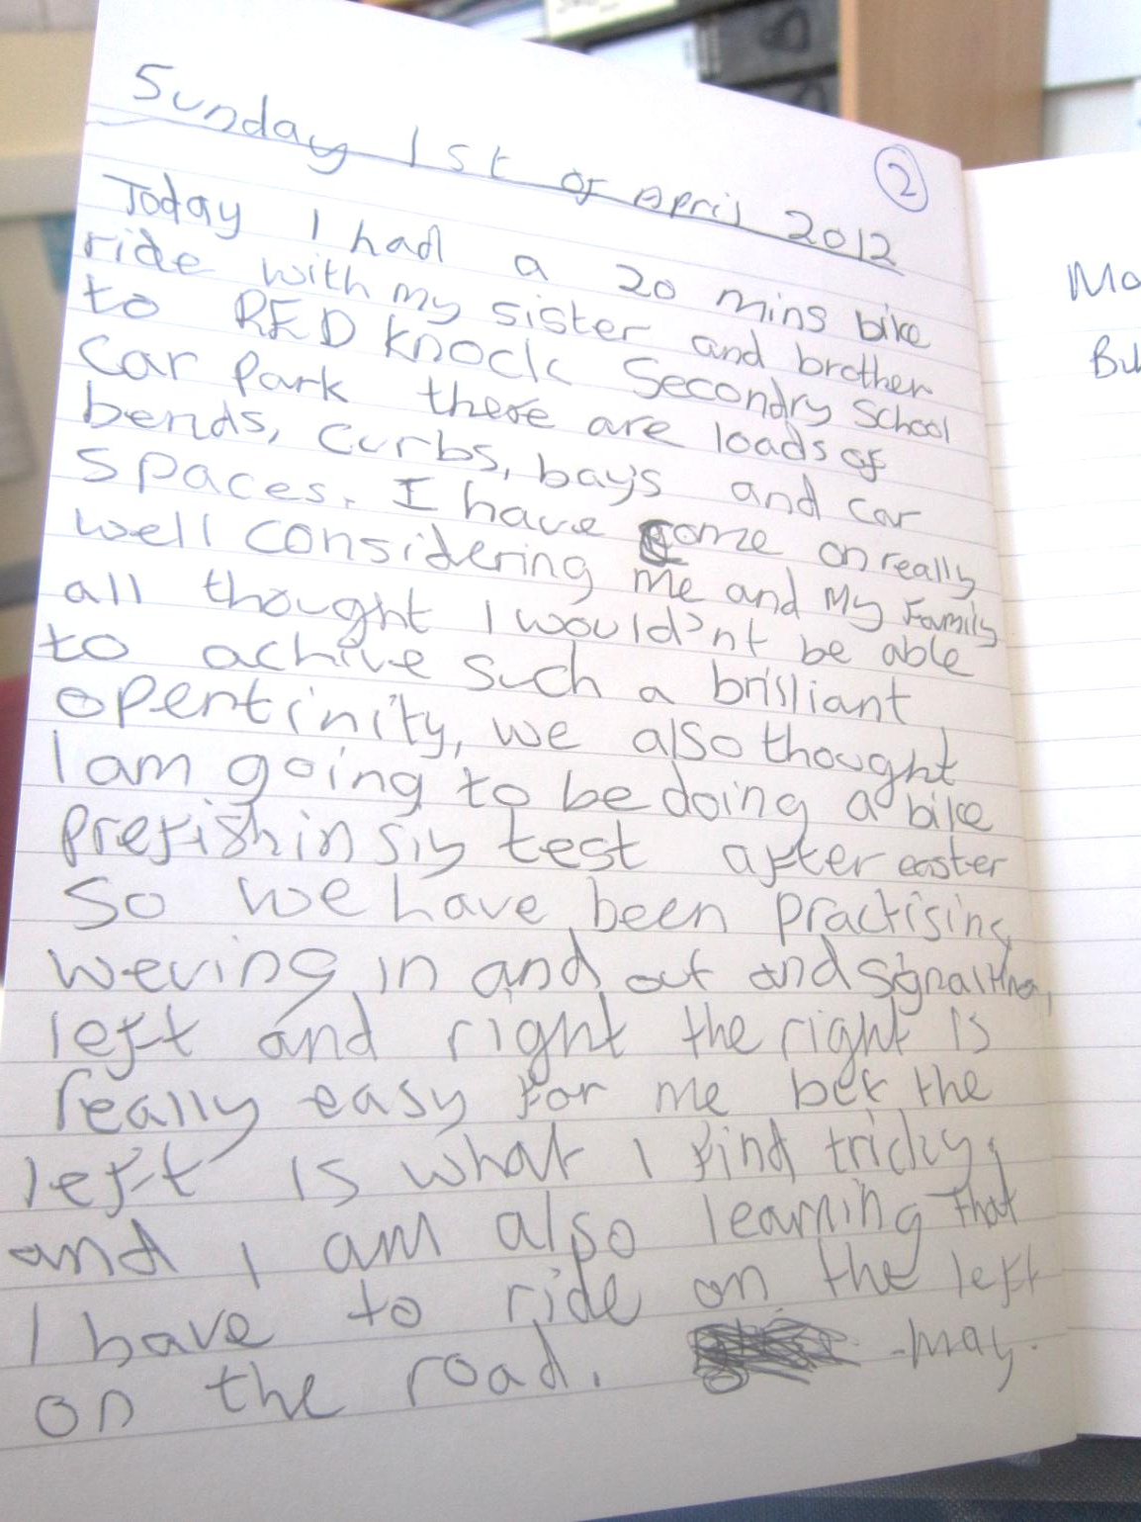
May’s diary entry
May age 10 years and has underdeveloped organs, dystonia and hemiplegia due to prematurity and having a stroke

Slide 18
May’s Cycling Ambitions
May ‘s own Diary entry (aged 10 years)
Today I had a 20 mins bike ride with my sister and brother to RK
Secondary school car park there are loads of bends, curbs, bays
and car spaces. I have come on really well considering me and
my family all thought I wouldn’t be able to achieve such a
brilliant opertinity, we also thought I am going to be doing a
bike prefishinsiy test after easter so we have been practising
weving in and out and signalling left and right the right is
really easy for me but the left is what I find tricky. and I am also
learning that I have to ride on the left on the road.
May

Slide 19
May’s Cycling School Trip
Interview:
Int:… So assuming you pass your cycling proficiency test, what do
you hope to do with your cycling?
M:..to get better and better at it.
Int: Where would you like to go with your bike?
M: H Forest
Int: Have you been there already?
M: Yeah but I had to go on a ‘stupid tandem’ because my teacher
kind of forced me…another Dad pedalled..
Mum: …It was sort of an ice cream basket on the back..
Int: So you didn’t do any pedalling at all?
M: No which was really, really, really disappointing…cos all my
other friends were like riding a bike and I was lonely….

Slide 20
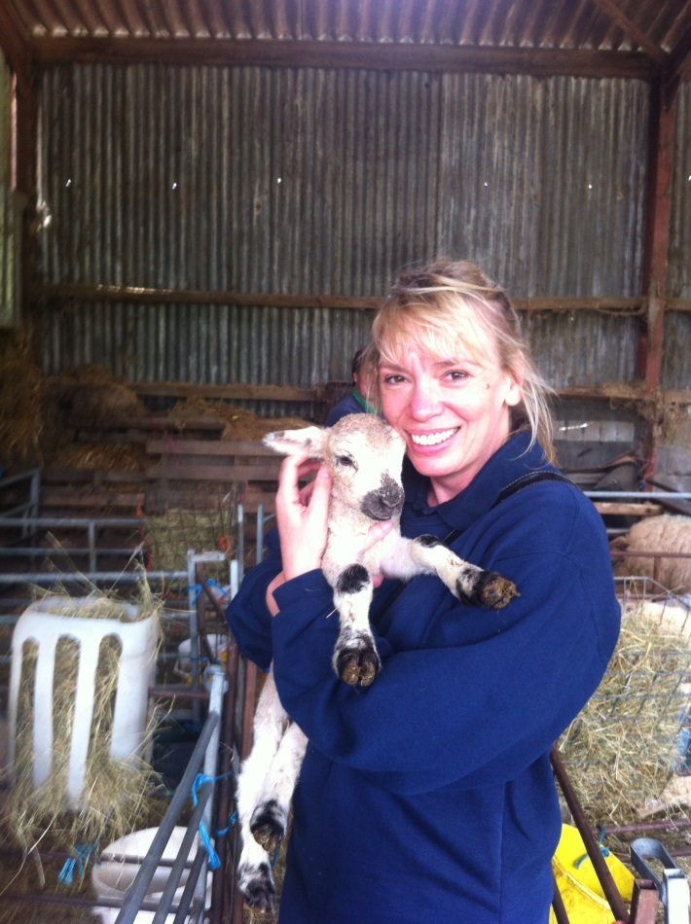
‘Basil’ 4 years, Hemiplegia, Makaton signing
Interview context: Mum
‘Farm is on a hill, he walks up and down hills over rough ground…..he falls over a lot…he runs, jumps, hops makes nests, scavengers and builds tepees…..has pony…will train for carriage driving in future…’
Notes:
April 2012

Slide 21
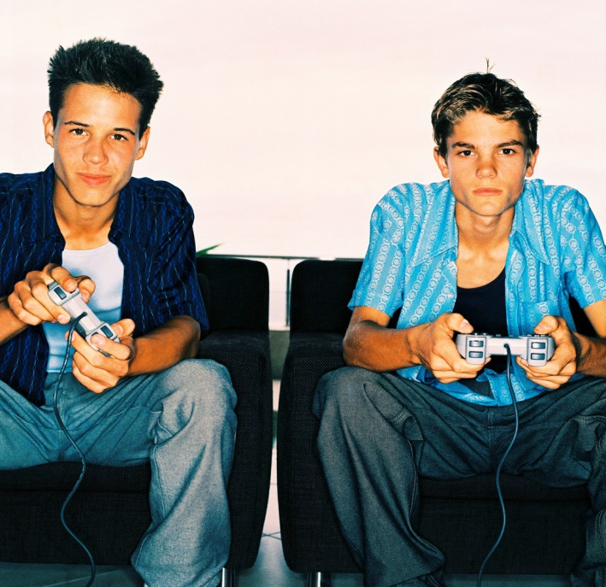
Personal and Cultural factors
Suarez
David and Eddie
Hussain
Natalie and Eddie
Lizzie and Wayne
Notes:
DP Hussain walked to the mosque, Suarez played wheelchair basketball, Natalie did cheer leading and steel drumming, Eddie did drumming, David and Eddie enjoyed their X box/ Wii and Lizzie and Wayne enjoyed dancing but did not like cycling.

Slide 22
Participation: Future research
Need to understand more about the different perspectives to facilitate an increase in participation in recreational activities:
Medical and Social models overlapping- cannot always ‘Fix’ the disability.
‘Function, Family, Fitness, Fun, Friends and the Future’ Rosenbaum and Gorter, 2013
Notes:
DP

Slide 23
Explore participation with disabled children and young people
Beyond Physiotherapy: Voices of children and young people with cerebral palsy and their carers about ‘Participation’ in recreational activities (VOCAL)

Slide 24
Imogen’s Digital story
I can walk…
I can do it by myself…
I was happy….
I always smile….
I can…I can!
I felt proud of myself….

Slide 25

Participation
Researcher
Practitioners
Parents(s)
Voices
Disabled Child
Notes:
DP

Slide 26

Future
Participation
Researcher
Practitioners
Parents(s)
Fun
Friends
Function
Disabled Child
Fitness
Family
Notes:
DP

Slide 27
Proposing
Research question: What are the lived experiences of Children & Young People with Cerebral Palsy and their carers about ‘Participation’ in recreational activities?
Method: Interpretative Phenomenological Approach
  Aim to make their ‘Voices’ louder and transparent

Slide 28
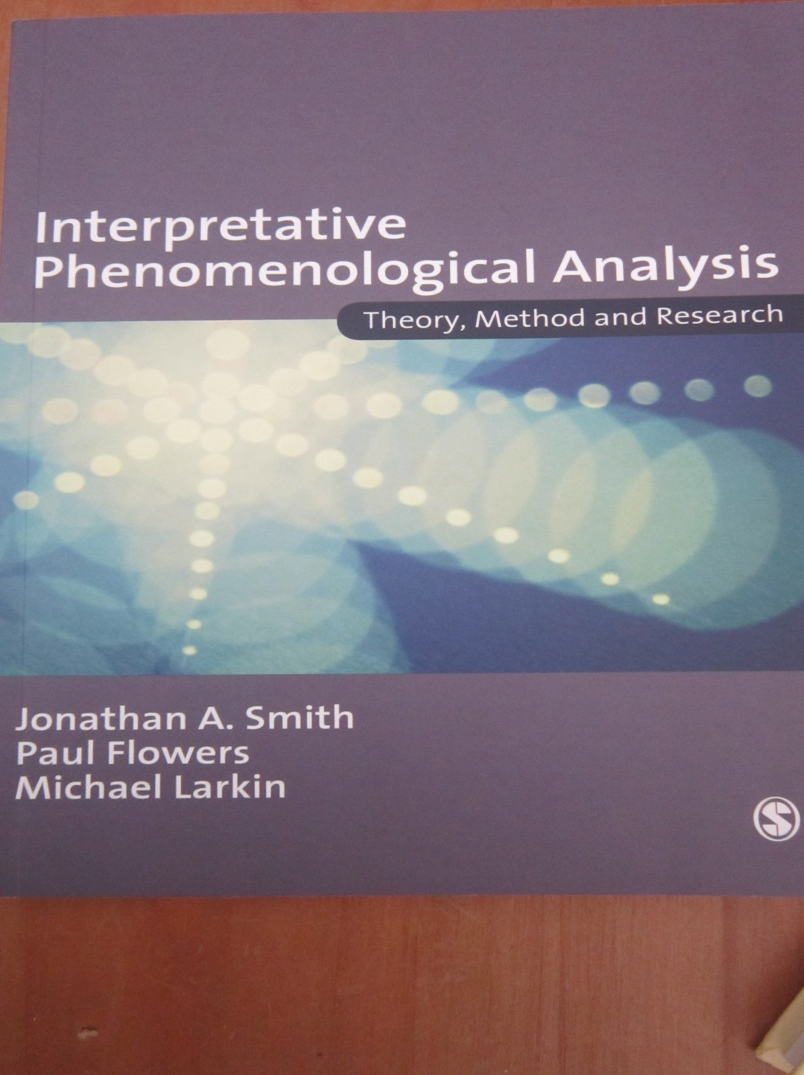

Slide 29
Questions ?
Dawn Pickering, Senior Lecturer,
Cardiff University’s School of Healthcare Sciences
Wales, United Kingdom
Email: pickeringdm@cf.ac.uk
Twitter:@DawnMPickering

